Slide 1

RIT-TECHPRAGNA’23
PROFITABILITY UNLEASHED!!!

Slide 2

CODE MAX
TEAM LEADER: N K S JEYAA
TEAM MEMBERS:
1)Jerita D
2)Lavanya M
3)Shamista S
4)Anitharani K

Slide 3

ABSTRACT
This project aimed to predict customer spending limits using various machine learning models and subsequently calculate the Return on Investment (ROI) based on user input. The models employed included Linear Regression, Support Vector Regression (SVR), XGBoost, AdaBoost, Gradient Boosting, Decision Tree, Random Forest, and a Feed Forward Neural Network. The primary objective was to create a predictive tool for estimating spending limits, optimizing marketing strategies, and calculating ROI.
The process involved dataset preprocessing, including K-Means clustering to segment customers and analyzing features like earnings, earning potential, and spending limits. The models were trained, evaluated, and compared to select the most accurate model for spending limit prediction. The Linear Regression model exhibited the highest accuracy, achieving 92% accuracy on average.

Slide 4

TECHNOLOGIES USED
Python
Streamlit

Slide 5
MODELS USED
Random Forest
Adaboost Regressor
Support Vector Regressor
Linear Regression
Feed Forward
K-means clustring
XGboostRegressor
DecisionTreeRegressor
GradientBoostRegressor

Slide 6
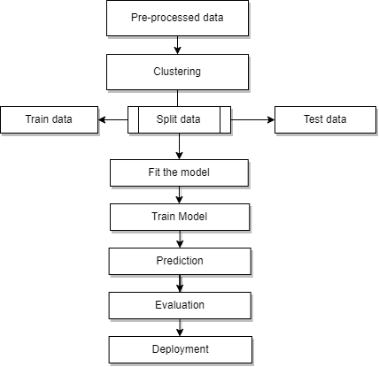
FLOW CHART

Slide 7
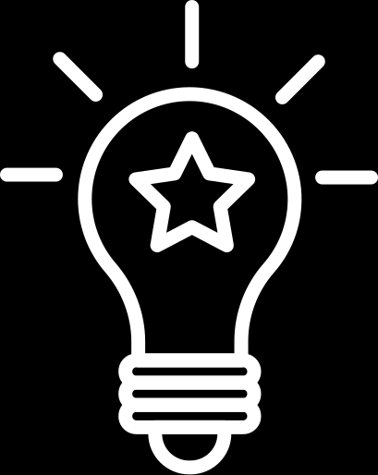
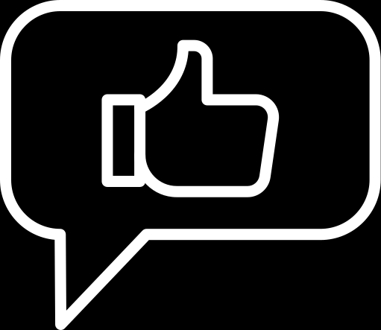
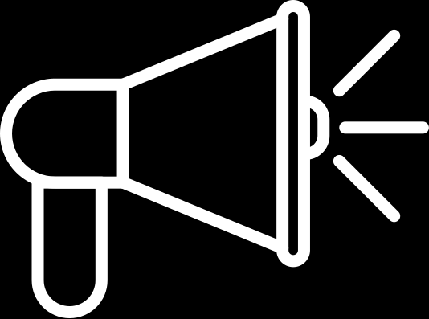
Our Goals
Goal # 1
Goal # 2
To predict the spending limit
To calculate ROI based on users input

Slide 8
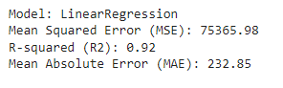
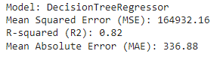
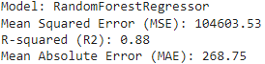
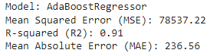
Our Milestones

Slide 9
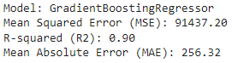
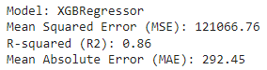
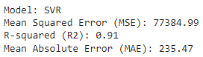
Our Milestones

Slide 10
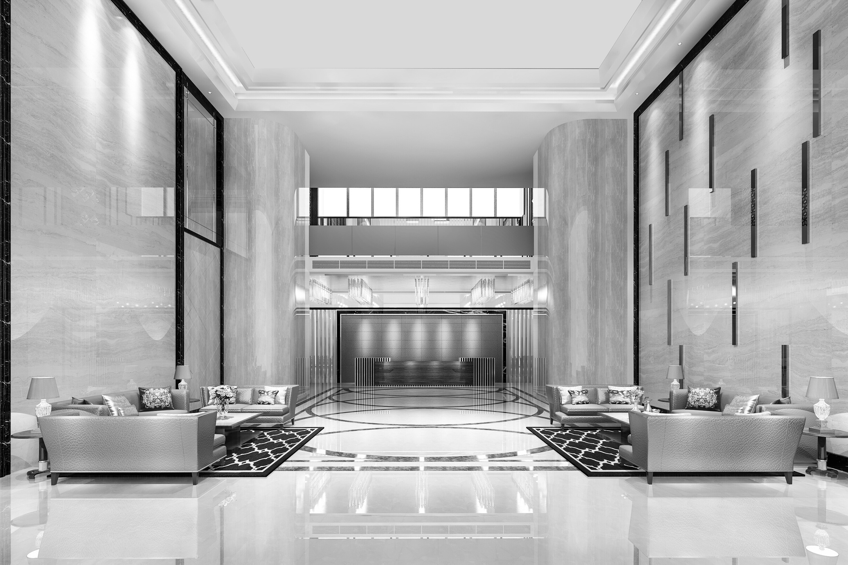
Thank you

